Slide 1

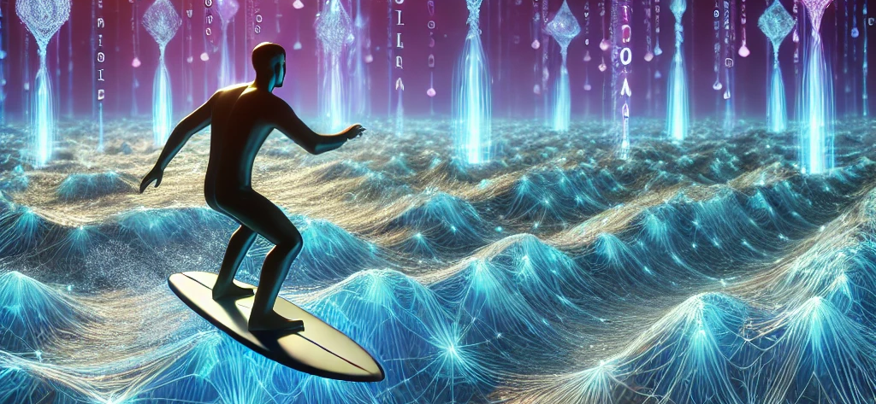

Team Surfers
Akshika, Neelarun, Amber (surfing the waves!)
Mentor: Dr. Yangkang Chen

Slide 2

Song
Waves by Fiji Blue
https://www.youtube.com/watch?v=jOJu2PRvUlo

Slide 3
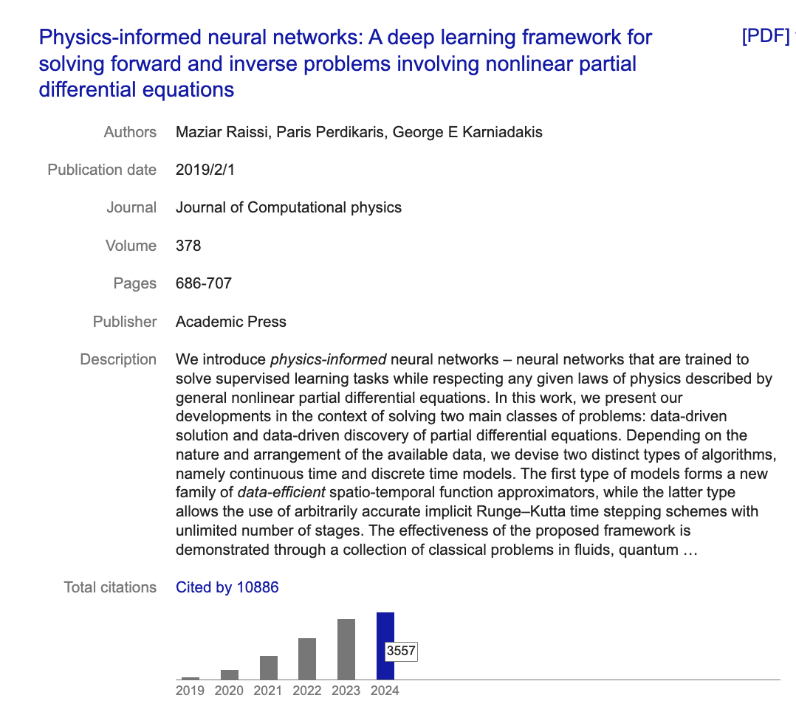
Interpretation of the Project
Solving PDE using Physics Informed Neural Networks (PINN)
Any PDE: Burgers Equation, Navier Stokes Equation, Wave Equation etc.
Loss Function incorporates the PDE and initial and boundary conditions as apriori information.

Slide 4
3 Major Milestones
1) Understanding the basics of PINN
2) Reproduce Burger’s equation with PINN
3) Produce wave equation with PINN

Slide 5
Check in 2
Major milestones: working on 1D wave equation
Minor milestones: creating PowerPoint
Team responsibilities:Ø
Amber: Theory
Akshika and Neel: Sensitivity Analysis
Akshika and Neel: Implementing wave equation
Planned resources

